Slide 1
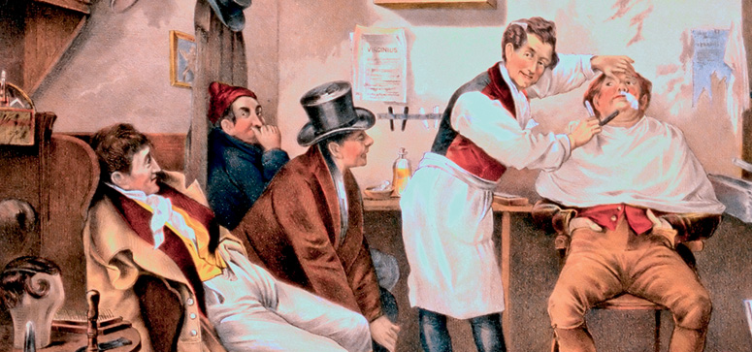
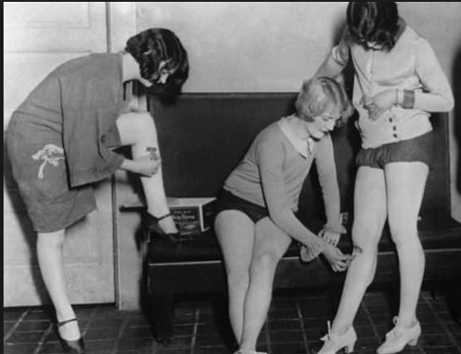
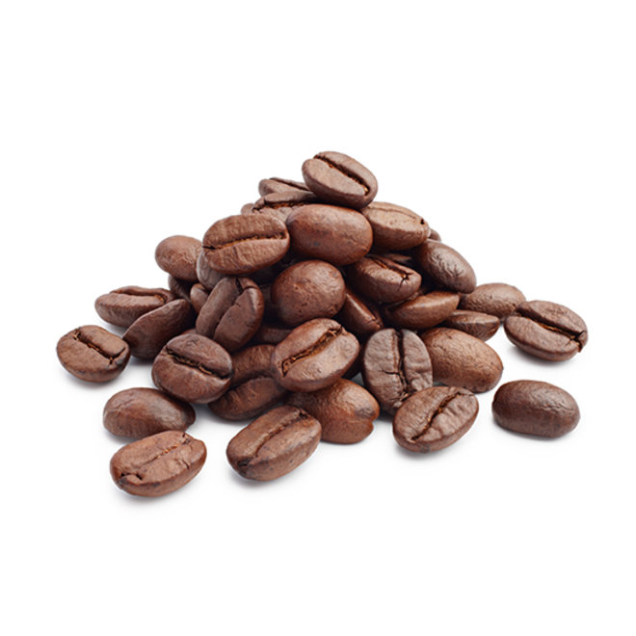
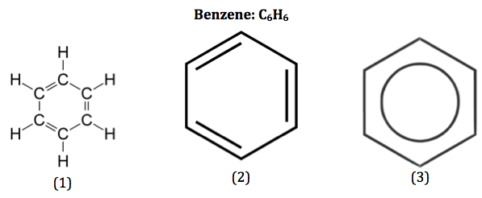
Chapter 16
Chemistry of Benzene:
Electrophilic Aromatic Substitution
Benzene was once used in shaving cream and as a solvent to decaffeinate coffee beans
~ How far we’ve come in the world ☺
Notes:
1

Slide 2
Outline
Background
Electrophilic aromatic substitution reactions: Bromination
Other aromatic substitutions
Administrative
Alkylation and acylation of aromatic rings:
The Friedel-Crafts reaction
Substituent effects in electrophilic substitutions
Trisubstituted benzenes: Additivity of effects
Nucleophilic aromatic substitution
Benzyne
Oxidation of aromatic compounds
Reduction of aromatic compounds
Synthesis of polysubstituted benzenes

Slide 3
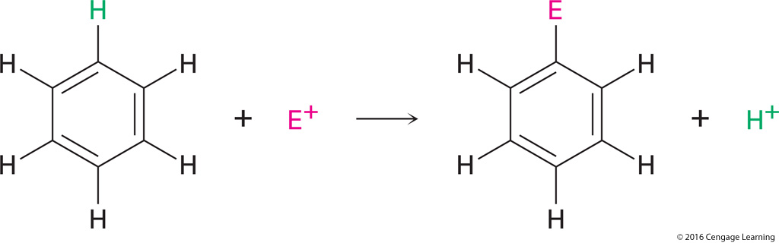
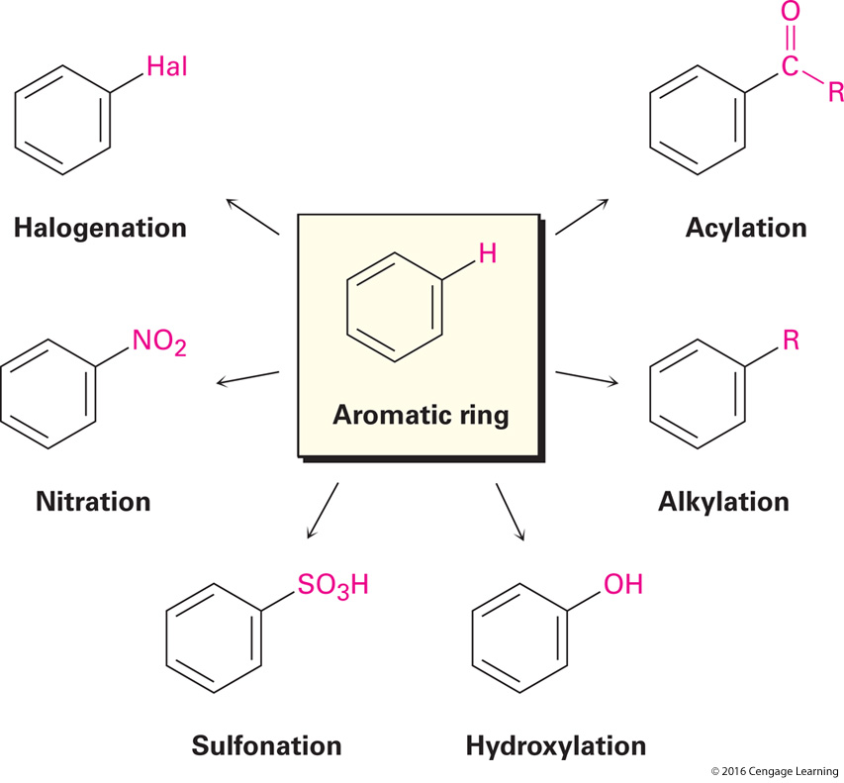
Background
Electrophilic aromatic substitution reactions:

Slide 4
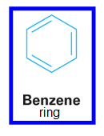
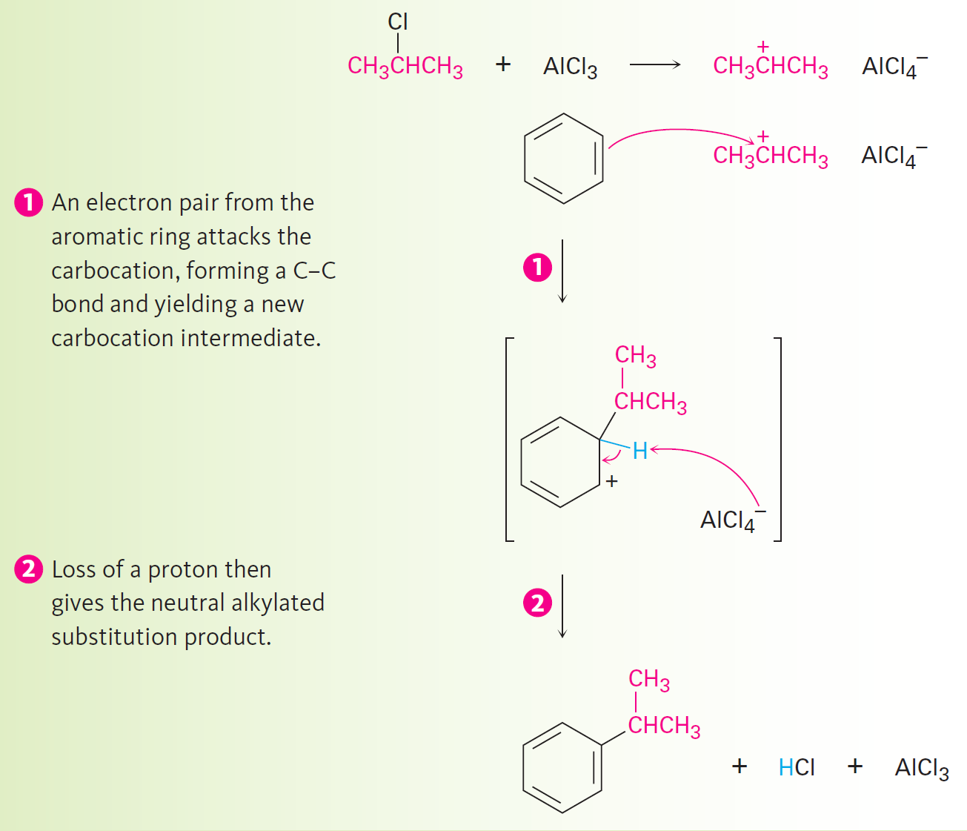
Alkylation & Acylation of Aromatic Rings:
The Friedel-Crafts Reaction
One of THE most useful electrophillic aromatic substitution rxns in the lab.
alkylation -
putting alkyl group (-CH₂CH₂CH₃) onto a benzene ring
Cl
(alkyl chloride)
CH₃CHCH₃
Treat aromatic compound
AlCl₃
NOTES: AlCl₃ catalyzes the rxn by helping the alkyl halide to dissociate
(similar to how FeBr₃ catalyzes Aromatic bromination by polarizing Br₂ ~ last lecture)
Alkylation: Introducing an alkyl group onto the benzene ring
  Also called the Friedel-Crafts reaction
  Involves treatment of an aromatic compound with an alkyl chloride to yield a carbocation electrophile
    Aluminium chloride used as a catalyst which causes dissociation of the alkyl halide
Notes:
Alkylation and acylation of aromatic rings: The Friedel-Crafts reaction
4

Slide 5
Mechanism of Friedel-Crafts Alkylation RXN
Chem 3900
Handout 1
Lecture 4
Chap 16
You Draw ☺
electrophile
nucleophile
Carbocation☹
Carbocation☹
H…..AlCl₄
_{(rearrangement)}
Notes:
Alkylation and acylation of aromatic rings: The Friedel-Crafts reaction
5

Slide 6
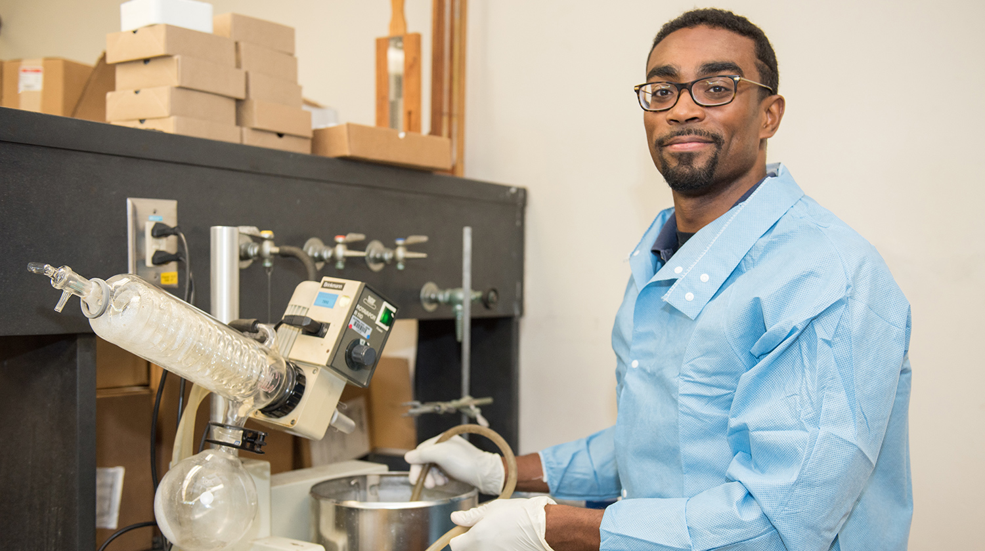
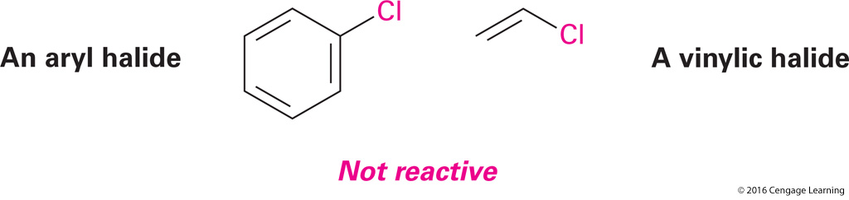
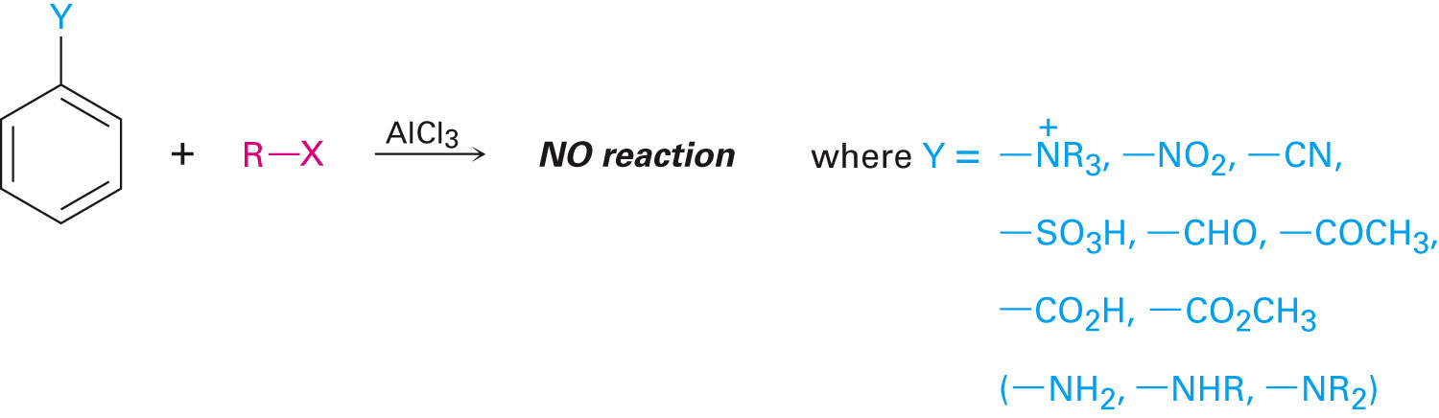
Limitations of the Friedel-Crafts Reaction
Despite it’s utility ~ there are five limitations:
Lets highlight them…(draw)
Cl
1) Only alkyl halides can be used:
CH₃CHCH₃
Assn. professor. P. Still, CSDH
a)
b)
2a
2b
2a) Aromatic (aryl) halides and 2b) vinylic halides don’t react
their carbocations(+) are too HIGH in E to form under Friedel-Crafts conditions
3) Doesn’t work on Aromatic rings with strong electronic withdrawing groups (Y)
:
:
NOTE: Y donates some of their electron density into a conjugated π systems
via resonance or inductive effects, thus making the π system less nucleophilic
Only alkyl halides can be used (F, Cl, I, Br)
  High energy levels of aromatic and vinylic halides are not suitable to Friedel-Crafts requirements
Not feasible on rings containing an amino group substituent or a strong electron-withdrawing group
Notes:
Alkylation and acylation of aromatic rings: The Friedel-Crafts reaction
6

Slide 7
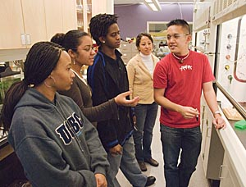
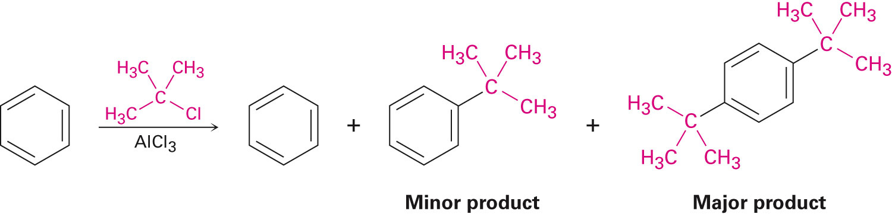
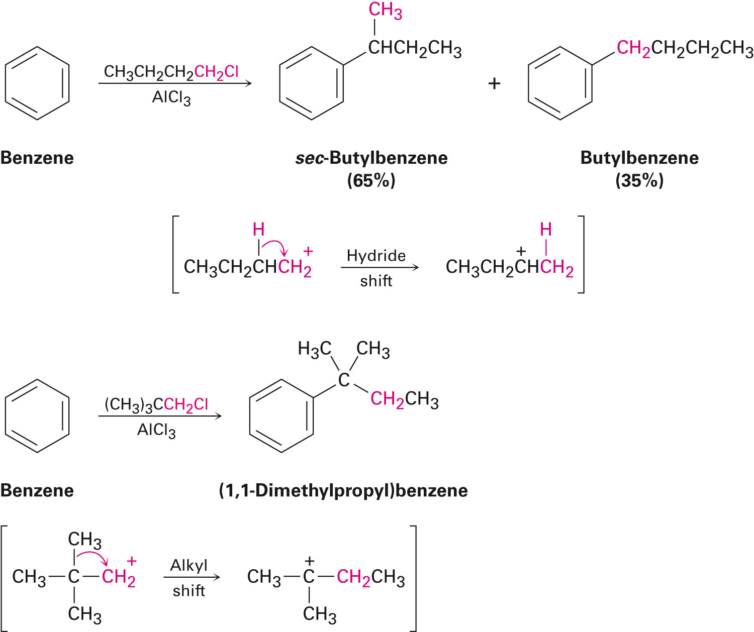
Despite it’s utility ~ there are five limitations:
4) Difficult to STOP the reaction after a single substitution
Assn. professor. B. Rubio, HCC
5) Occasional skeletal structure “rearrangements” occur of the alkyl carbocation ☹
2a) Aromatic (aryl) halides and 2b) vinylic halides don’t react
(their carbocations are too
1ºcarbocation⁺
unstable
2º carbocation⁺
stable ☺
1º ^{carbocation+}
unstable
3º ^{carbocation}
stable ☺
Recall: Hydride & Alkyl shifts to stablize carbocation intermediates (Sect 7-11)

Slide 8
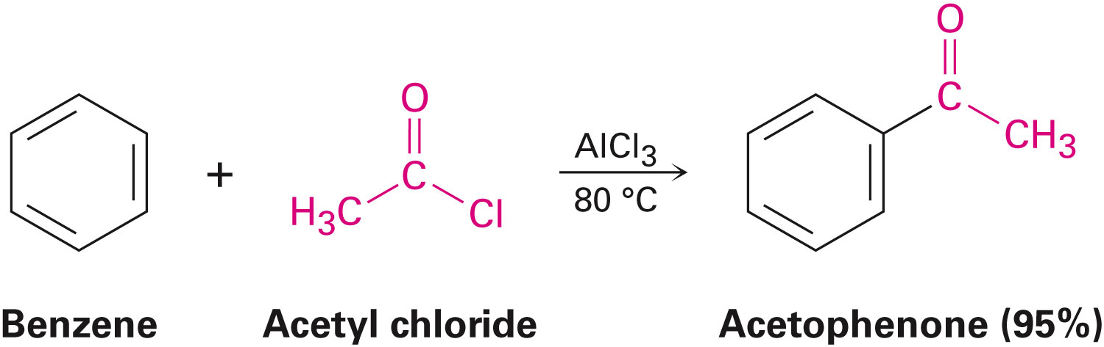
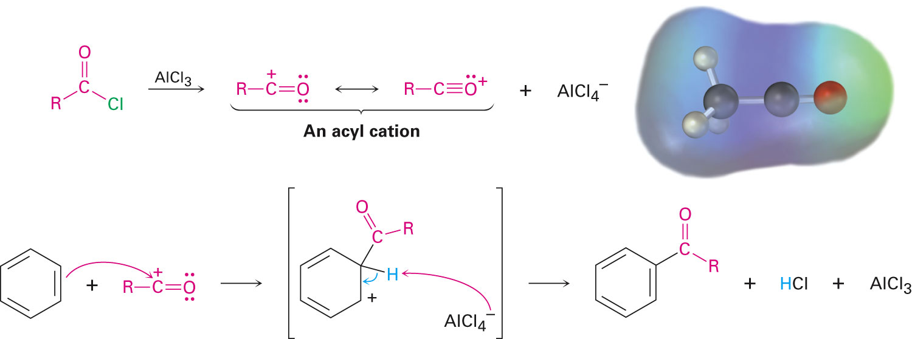
Mechanism of Friedel-Crafts Acylation RXN
Background
acyl group C=O
(-COR)
Mechanism is similar to akylation (previous slides), same limitations (1-5) apply
resonance stabilized carbocation⁺
AlCl₄⁻
What’s the nucleophile?
electrophile?
H + AlCl₄⁻ rearrangement…

Slide 9
Friedel-Crafts Acylation RXN
1) Unlike multiple substitutions in Friedal-Crafts alkylations…
2) Acylations NEVER occur more than once in a ring. ☺
b/c the product (b) is less reactive than the nonacylated starting material (a)
(a)
(b)

Slide 10
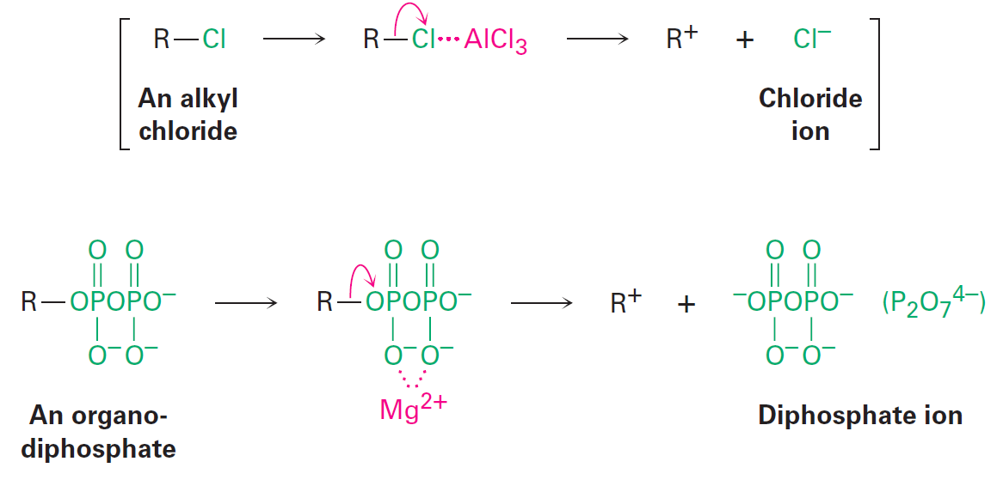
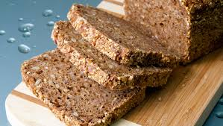
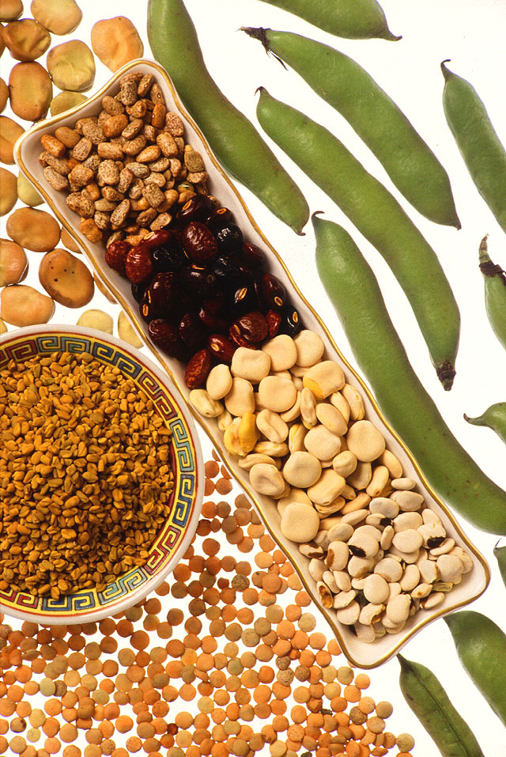
Background
Aromatic acylations occur in numerous BIOLOGICAL pathways
(however no AlCl₃ is availb. to be an electrophile ☹ like below)
carbocation
electrophile
nucleophile
Instead in Nature the carbocation electrophile is typically formed by dissociation of
an Organo-di-phosphate assisted by complexation to a divalent metal cation e.g. Mg²⁺
(just like the dissociation of an alkyl chloride is assisted by AlCl₃ above)
carbocation
electrophile
nucleophile
Sources of Mg²⁺

Slide 11
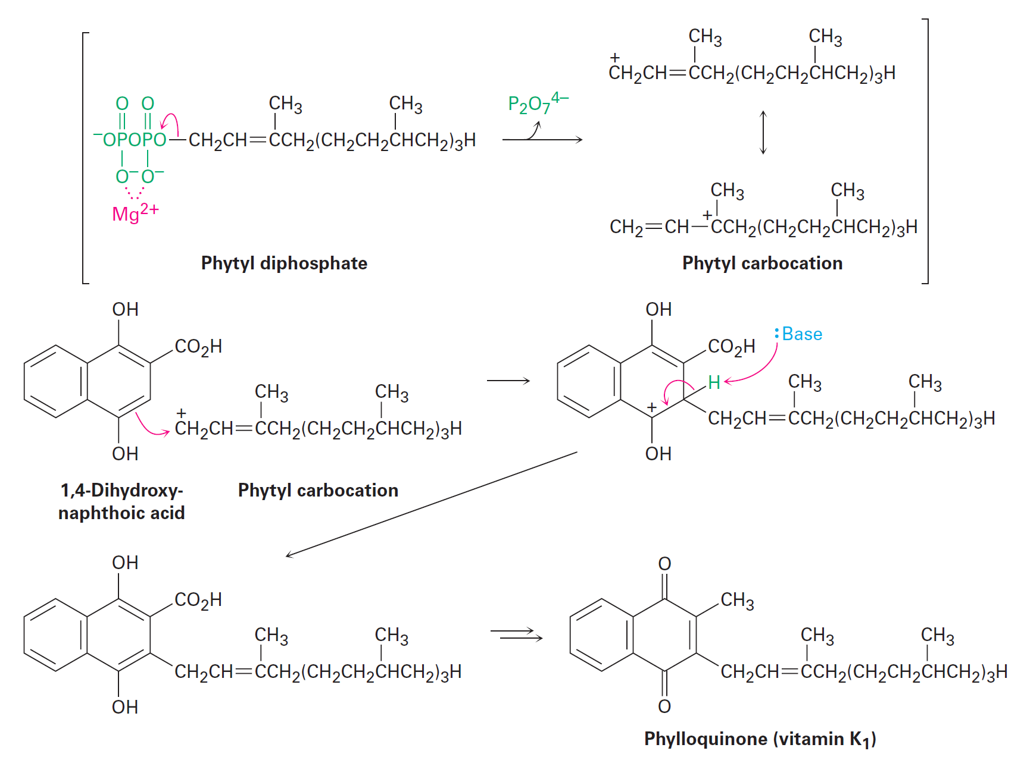
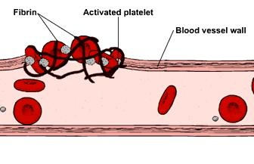
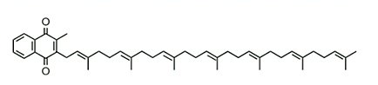
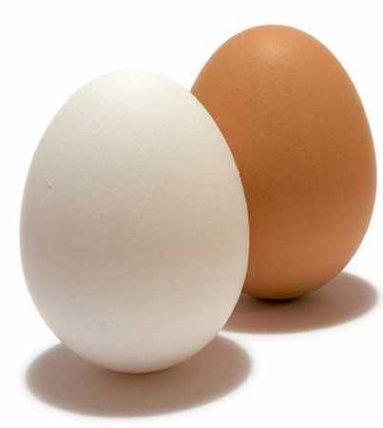
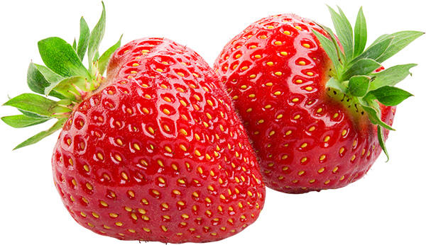
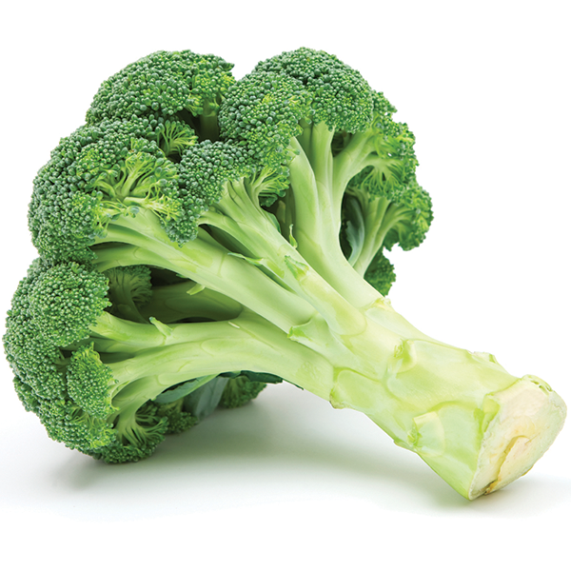
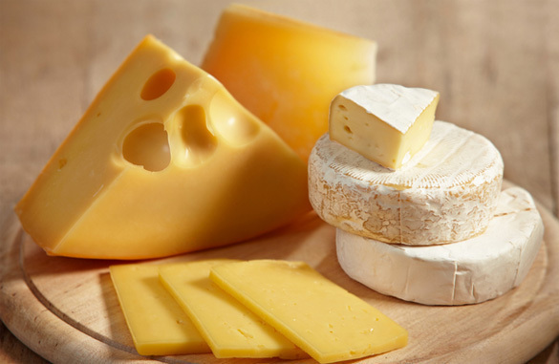
BIOLOGICAL pathways
~ Friedel-Crafts Alkylation (in Nature)
Background
☺
Dietary sources
NOTES: Vitamin K is an essential precursor for proteins involved in blood clotting and controlling binding of Ca²⁺ in bones and other tissues (related to osteoporsis). Our body can’t produce ample amt. (some microbes in our gut can ~ antibiotics can destroy ☹). Crohns disease, celiac patients and small children are at risk for Vit K. deficiency. Babies often get an injection ~ beneficial for early development.
https://www.webmd.com/vitamins-and-supplements/supplement-guide-vitamin-k#2-3

Slide 12
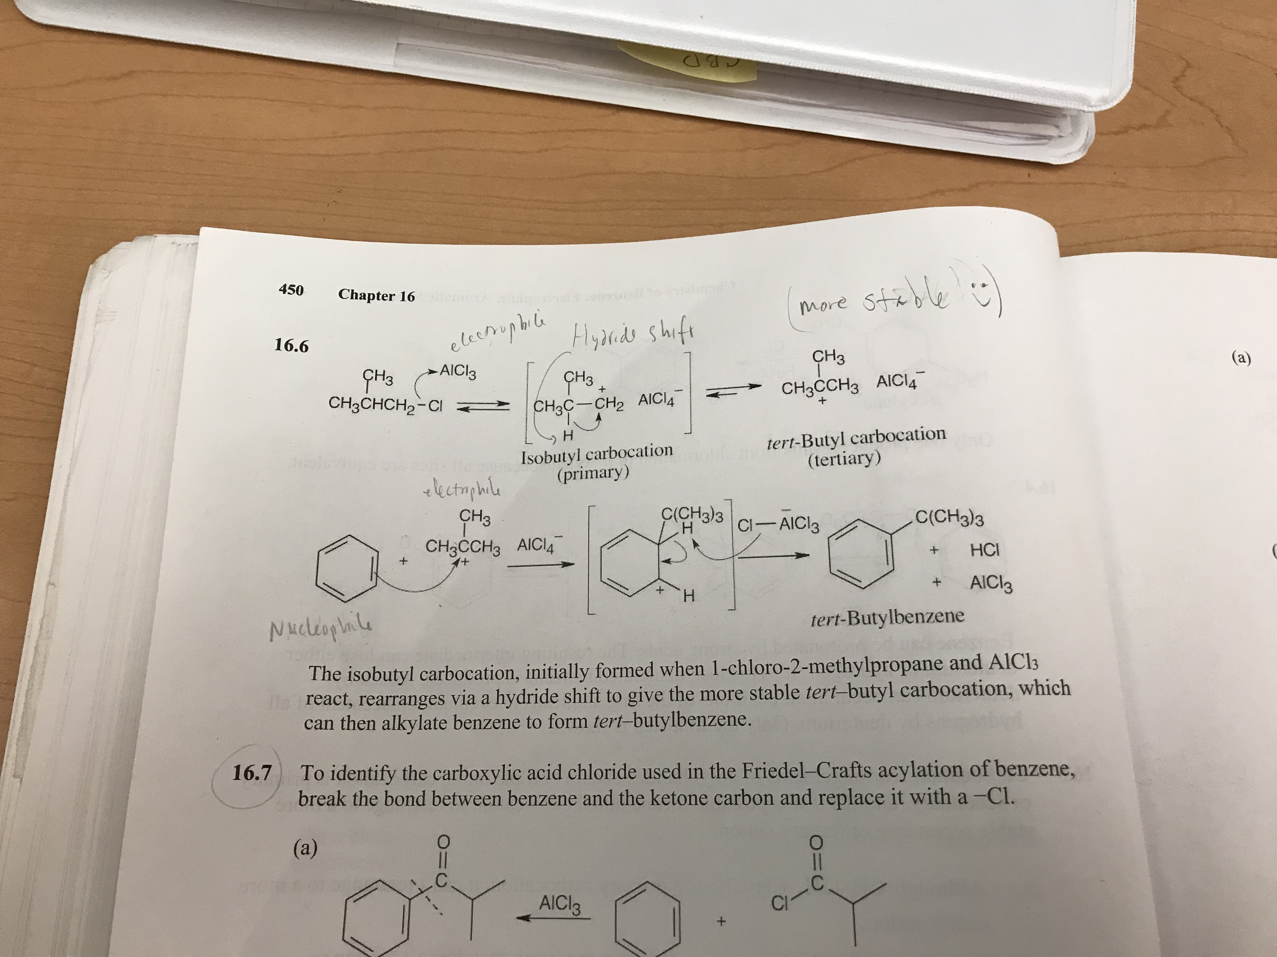
Challenge Question
Chem 3900
Lecture 4
Worksheet 1
What is the major monosubstitution product from the Friedel-Crafts rxn of:
Benzene with 1–chloro-2-methylpropane in the presence of AlCl₃?
Hint 1: Draw structures of:
a) 1-chloro-2-methylpropane
reacting w/ AlCl₃
b) Benzene
c) Write out the
Mechanism(s)
(see prev. notes)
more stable
Hint 2: What is no. 5 limitation of the “Friedal Crafts reaction” (see previous notes)

Slide 13
Outline
Background
Electrophilic aromatic substitution reactions: Bromination
Other aromatic substitutions
Alkylation and acylation of aromatic rings:
The Friedel-Crafts reaction
Substituent effects in electrophilic substitutions
Trisubstituted benzenes: Additivity of effects
Nucleophilic aromatic substitution
Benzyne
Oxidation of aromatic compounds
Reduction of aromatic compounds
Synthesis of polysubstituted benzenes

Slide 14
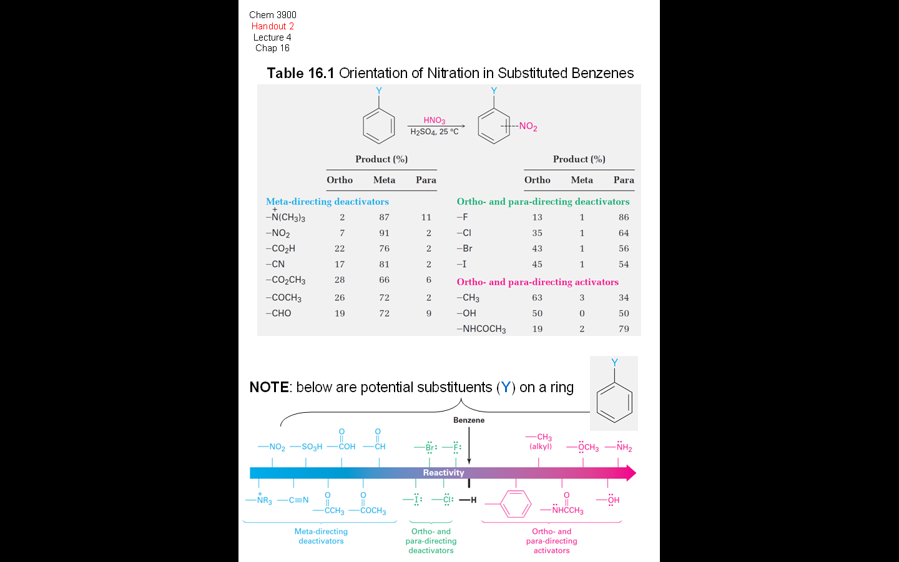
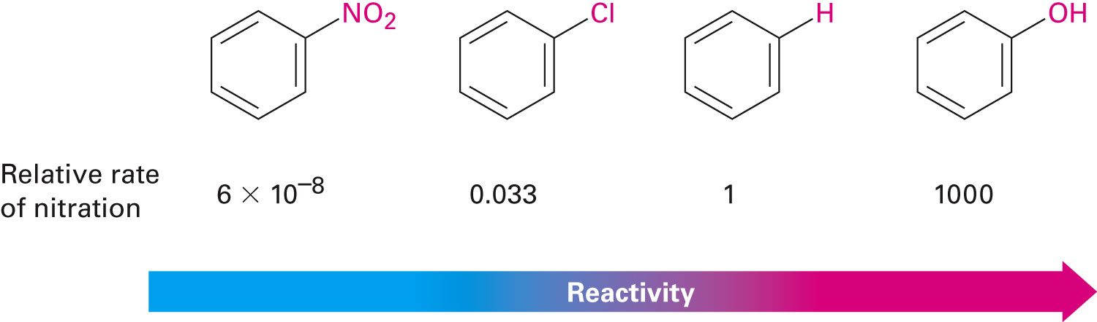
Substituent effects in electrophilic substitutions
What happens if we carry out a rxn on an Aromatic ring that already has a substituent?
Two effects:
1) Some activate the ring (making it more Reactive than Benzene)
2) Some de-activate the ring (making it less reactive than Benzene)
nitration
e.g.
Y =
X more reactive ☺
10 Million times
less reactive ☹
1)
2)

Slide 15
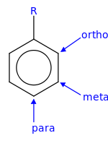
a
Handout 2a
(HNO₃)
Substituents affect the orientation
of the reaction.
The 3 possible disubstituted products:
ortho (o), meta (m), para (p) are
NOT formed in equal amounts.
1)
2)
, -NH₂
The chemical nature of the 1st substituent (Y, e.g. -CHO, -CH_{3,} -OH…)
on benzene ring determines the
position of 2nd substituent…
e.g.
1) if Y = -CHO (structure above), this directs NO₂ mainly to meta positions (72%)
2) If Y = -OH, this directs NO₂ to the ortho (50%) & para (50%) positions

Slide 16
b
Handout 2b
Substituents can be classified into three groups (please annotate below)
1)
2)
3)
NOTES: 1) There are Meta-directing de-activators.
2) Halogens are weakly -ortho & -para directing de-activators
3) Ortho and-para directing activators

Slide 17
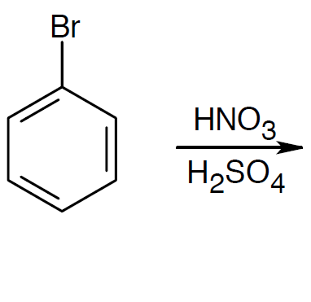
Confirming Your Knowledge
Chem 3900
Lecture 4
Worksheet 2
Predict the major product(s) in the nitration (NO₃) of bromobenzene?
(~43% yield)
(~56% yield)
Hint: see Handout 2a, Table 16.1
Notes:
Substituent effects in electrophilic substitutions
17

Slide 18
Now lets talk about:
de-activating or activating effects
that influence the reaction on rings in more detail…

Slide 19
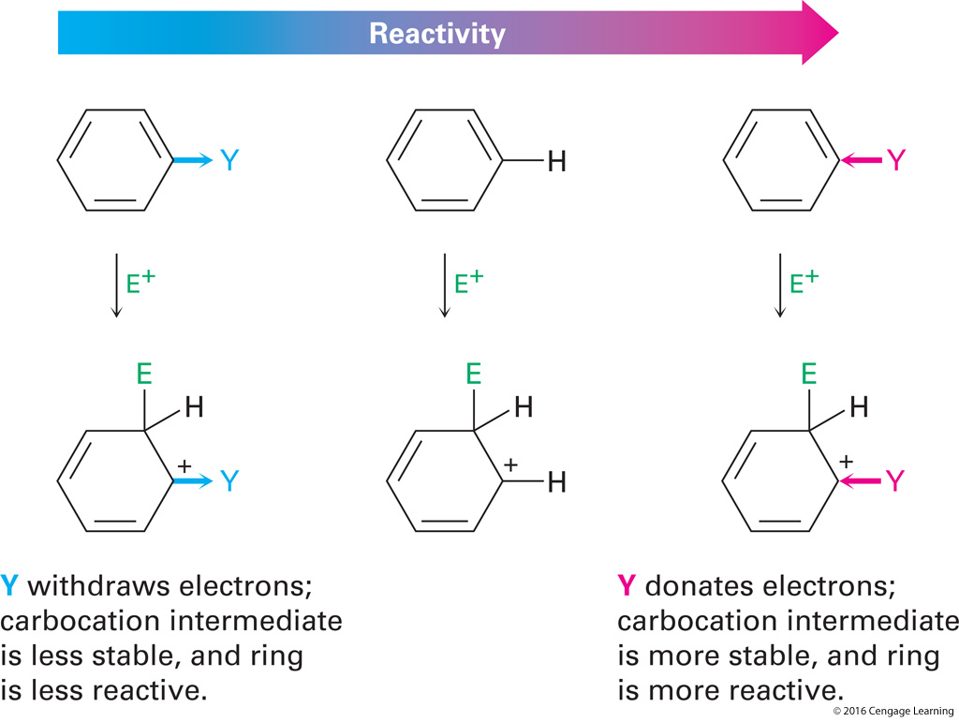
Chem 3900
Handout 3
Lecture 4
Chap 16
What makes a group either: 1) de-activating or 2) activating?
1)
2)
If substituent-
benzene = standard.
(neutral)
If substituent-

Slide 20
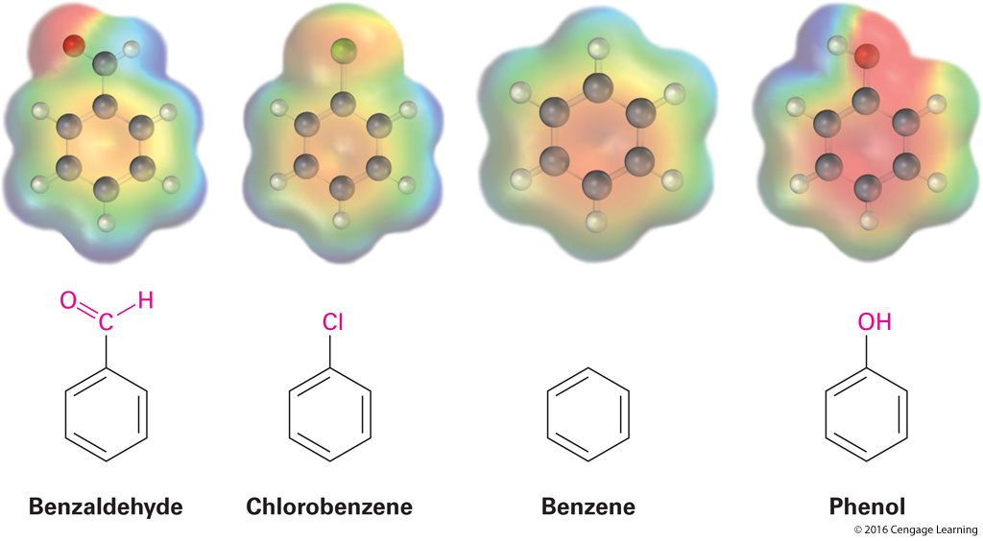
Note: compare the electrostatic potential Map below
Background
Ring is more POSITIVE (yellow-green) when e- withdrawing groups are present: A & B
Ring is more negative (red) when e- donating group is present C:
neutral = standard
A)
B)
C)
All influenced by….

Slide 21
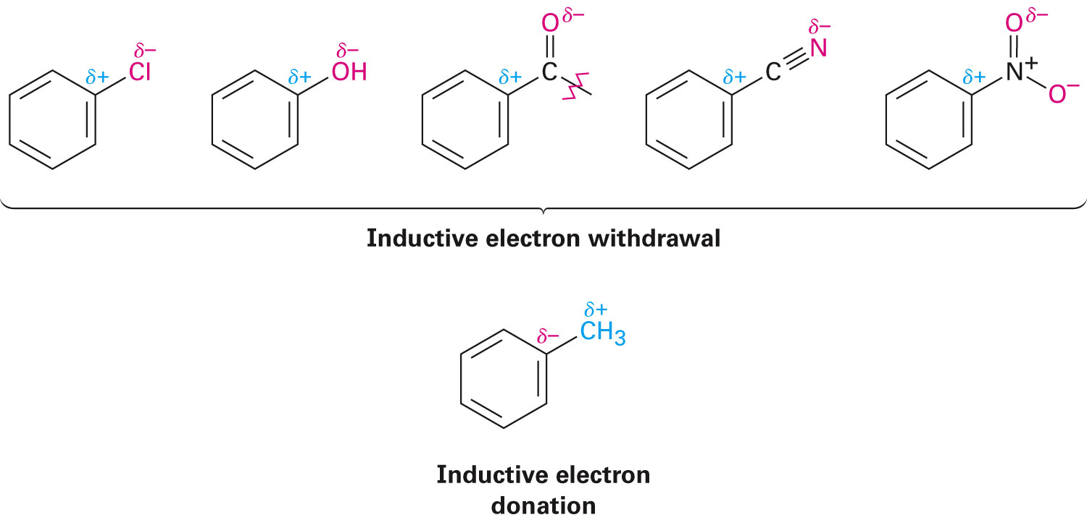
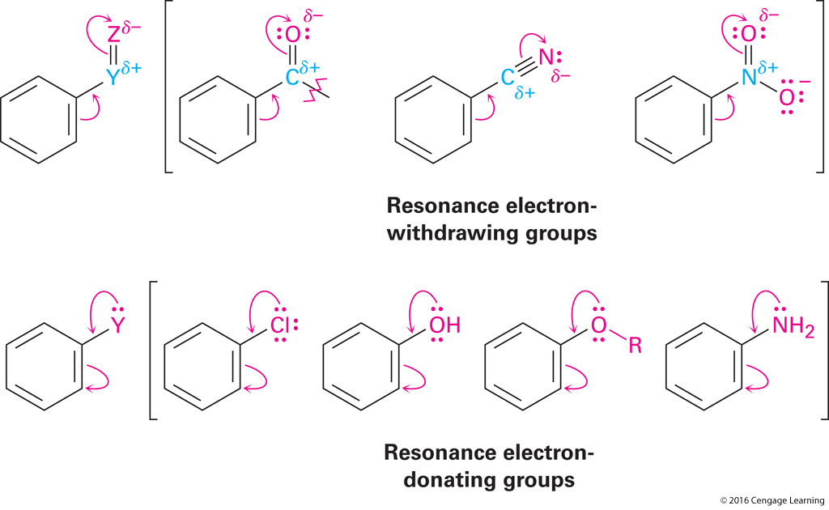
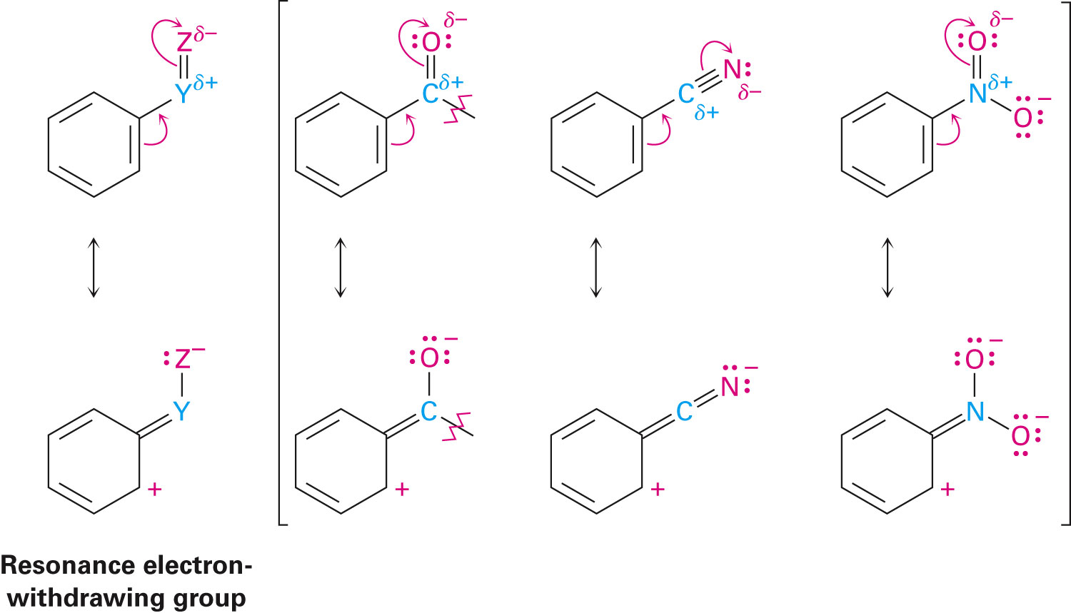
RECALL
Chap 2.1
1) Inductive effects:
a) withdrawal or b) donation of e- thru a σ bond
(based on electronegativity)
a)
b)
2) Resonance effects:
a) withdrawal
or
b) donation
of e- thru a π bond due to overlap
of a p orbital on substituent (Z or Y) w/ p-orbital on ring

Slide 22
So what’s happening and why?

Slide 23
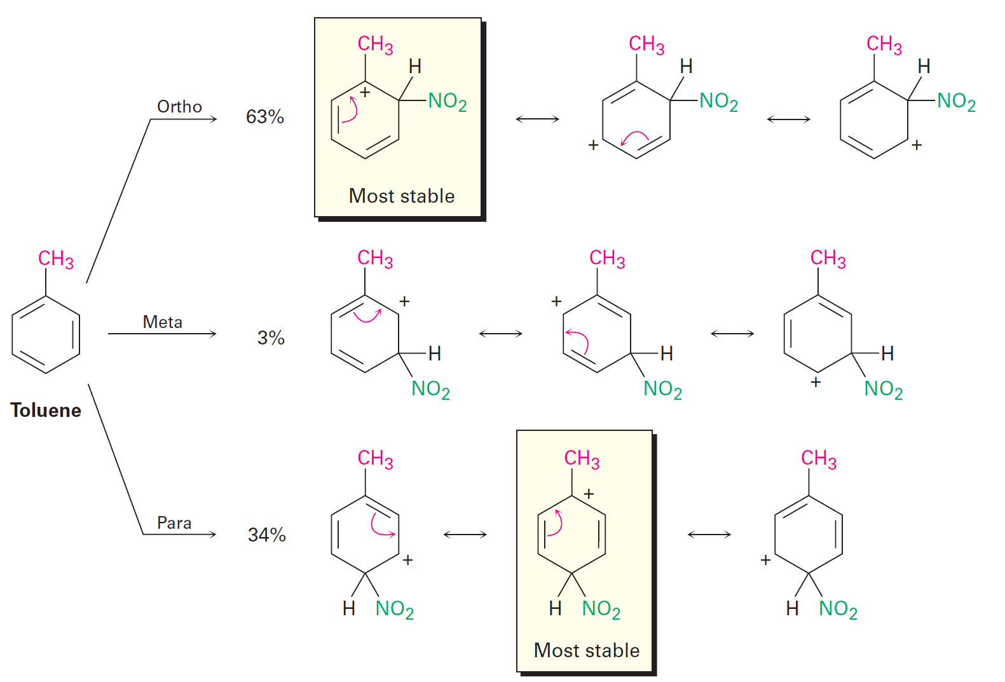
Alkyl groups
Ortho- and para-Directing activators:
Figure 16-13
Inductive and resonance effects
influence orientations and (yields)
of aromatic substitutions…
e.g.
see Handout 2
☺
HNO₃
H₂SO₄
NOTES: Ortho and Para carbocation⁺ compounds are more stable than Meta
b/c their + charge is on 3º (boxed) vs 2º carbon (all the rest)

Slide 24
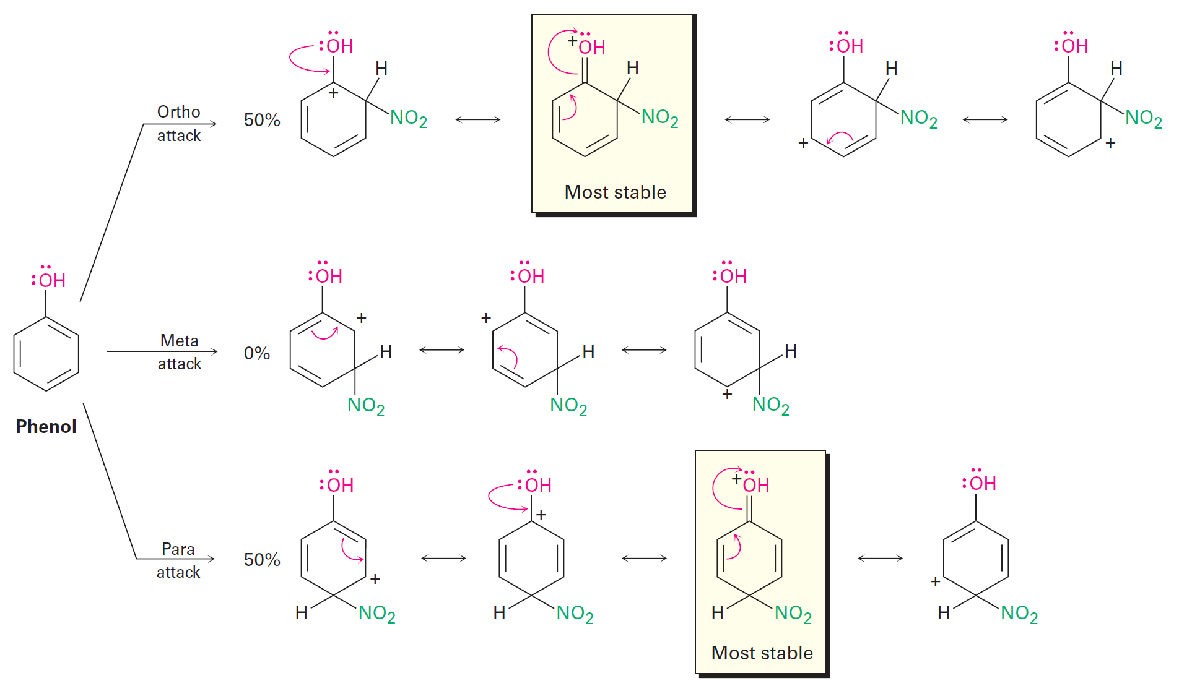
OH & NH₂ groups
Ortho- and para-Directing activators:
Yields are 50:50 (ortho:para)
Figure 16-14
HNO₃
H₂SO₄
NOTES: Ortho and para carbocation⁺ compounds are more stable b/c they have more resonance forms (4) vs the meta form (3) shown above.
The most favorable form (boxed) has + charge stabilized on lone pair of :OH

Slide 25
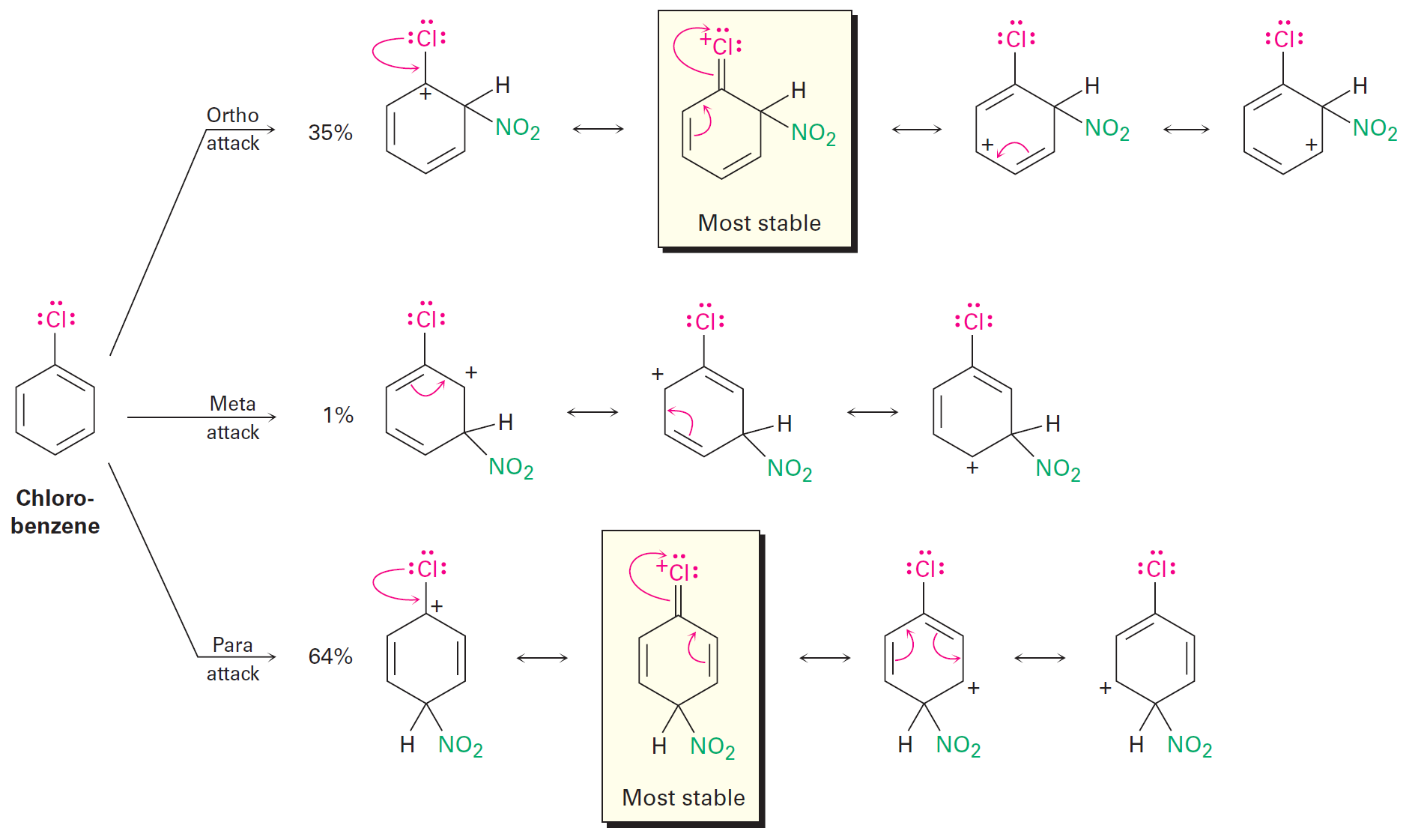
Halogens
Ortho- and para-Directing De-activators:
Figure 16-15
HNO₃
H₂SO₄
NOTES:
Halogens are De-activators b/c their strong a) electron withdrawing inductive effects
outweighs their weaker b) electron donating resonance effects
The most favorable carbocation(s)⁺ (boxed) have + charge stabilized on :Cl lone pair

Slide 26
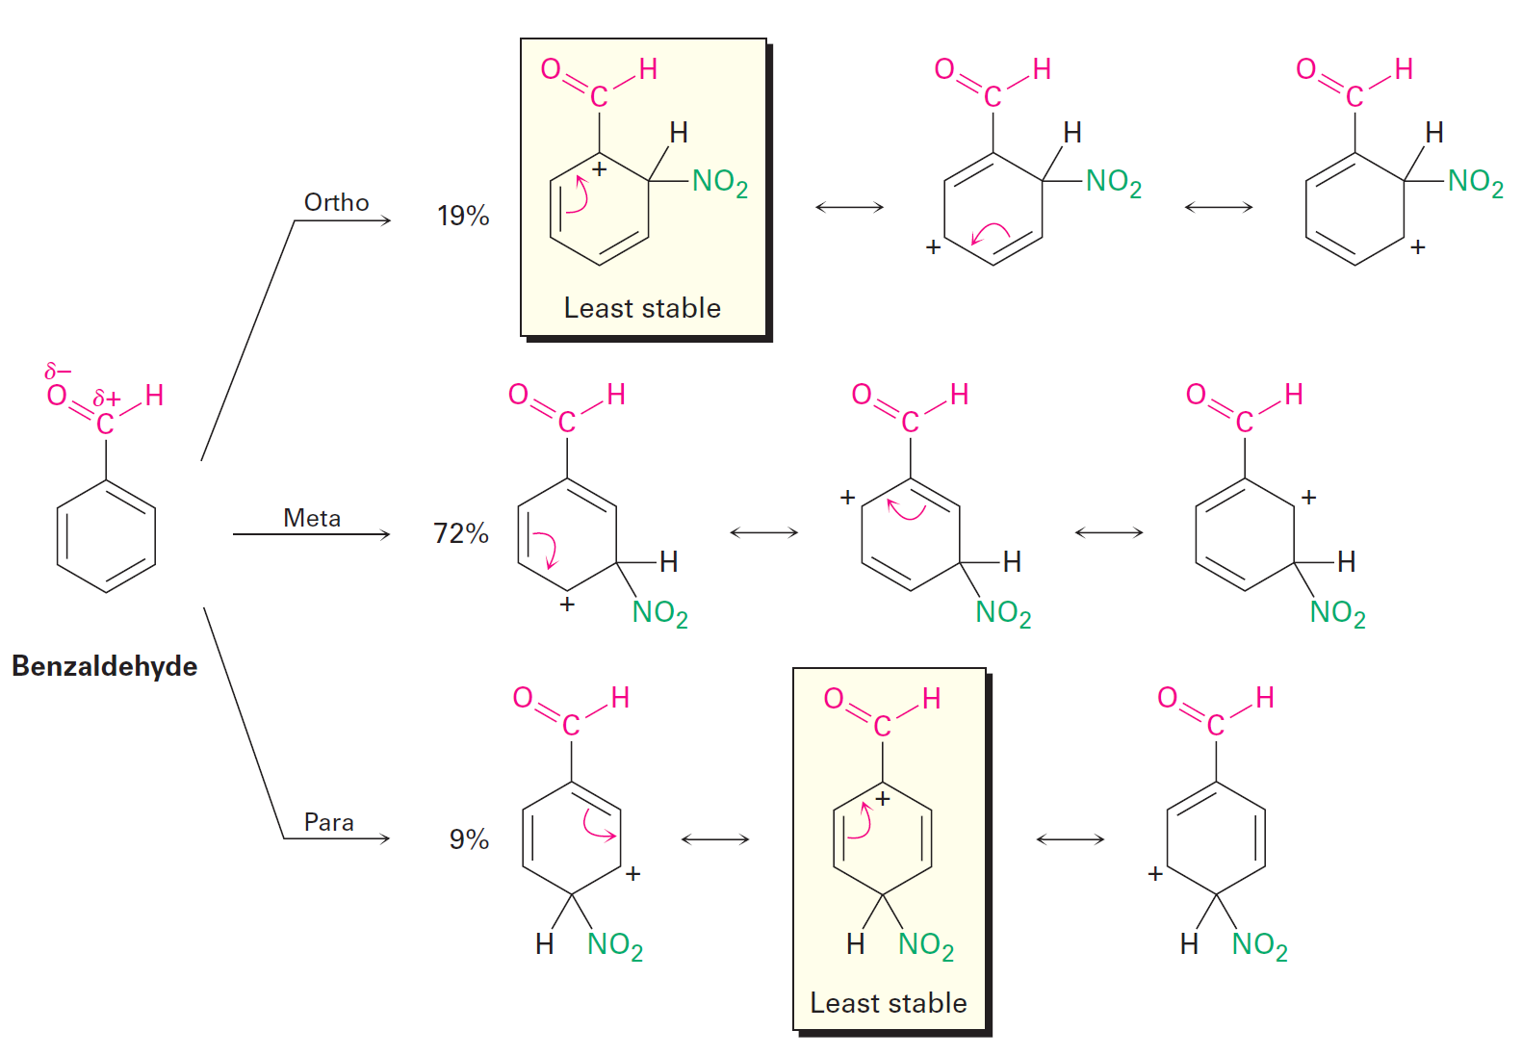
Meta-Directing De-activators:
Figure 16-16
δ-
..
:
δ+ ☹
HNO₃
H₂SO₄
NOTES:
Here the Meta carbocations have 3 favorable resonance forms, while the ortho and para
carbocations have two. The least stable resonance forms (boxed) are unfavorable (---)
b/c they place a + charge on the carbon next to a positively polarized carbon (δ+).
The most favorable carbocation stabilizes positive charge+ by from lone pair on :Cl: like

Slide 27
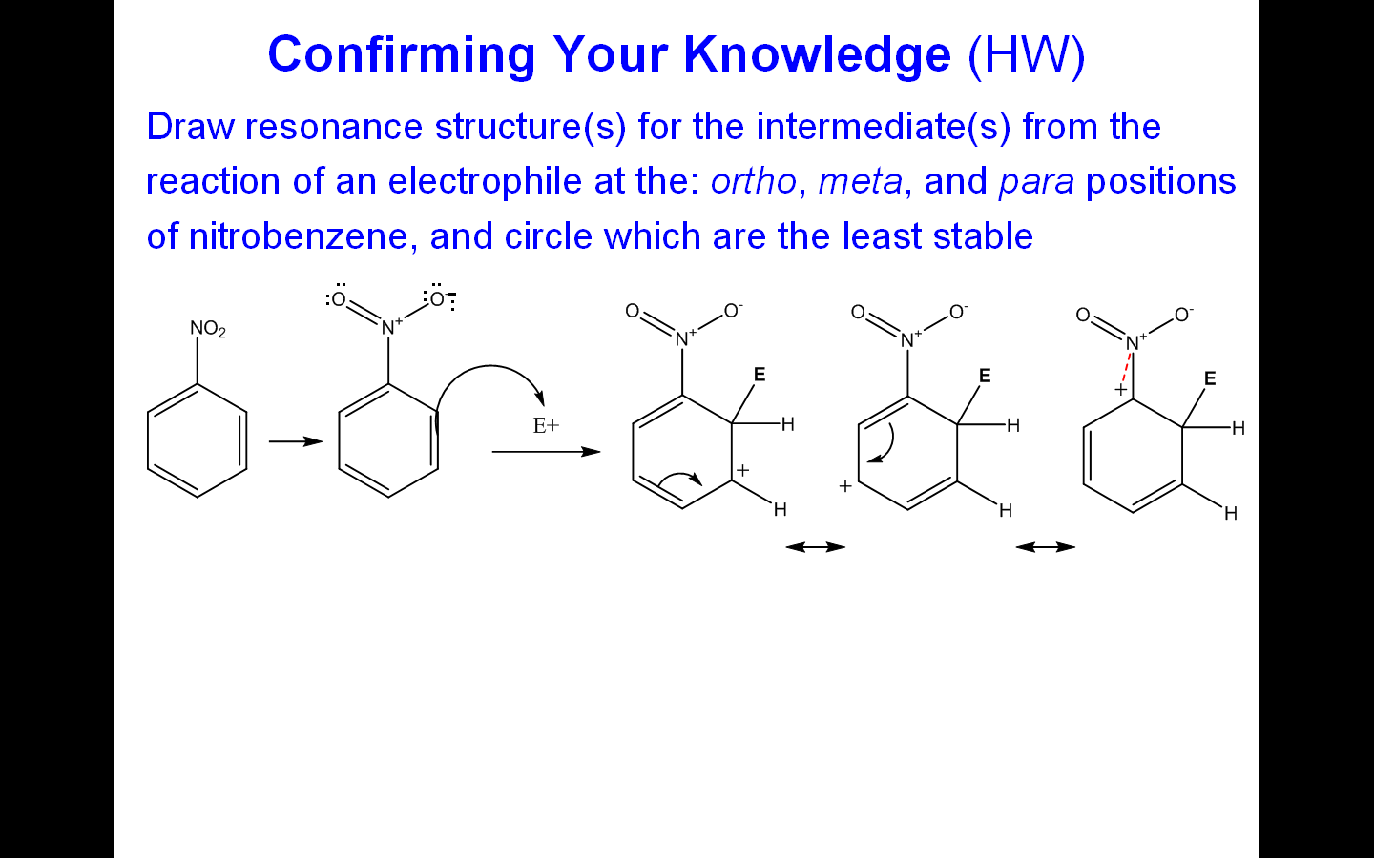
Take Home Challenge (THC) Question - HW
Chem 3900
Lecture 4
Worksheet 3
( 5 min.)
Draw the resonance structure(s) for the intermediate(s) from the reaction of a electrophile (E⁺)
at the: ortho position (below) of nitrobenzene, and circle the least stable.
Note: see prev. slides Handout 2a
solution available @ Faculty office hours or contact our TAs for assistance –
Notes:
Substituent effects in electrophilic substitutions
27

Slide 28
Take Home Challenge (THC) Question - HW
Chem 3900
Lecture 4
Worksheet 3
Draw the resonance structure(s) for the intermediate(s) from the reaction of a electrophile (E⁺)
at the: ortho position (below) of nitrobenzene, and circle the least stable.
ortho attack
Hint:
Notes:
Substituent effects in electrophilic substitutions
28

Slide 29
Challenge Question
Chem 3900
Lecture 4
Worksheet 3b
What is the major monoalkylation product(s) you would expect to obtain from the rxn of
chloromethane (CH₃Cl), AlCl₃ and 2,4, dichloronitrobenzene?
Hint:
Draw the structure of
2,4, dichloronitrobenzene
SKIP
NO₂
meta
directing de-activators
Cl (X)
ortho, para -
directing de-activators
(weak activators)
Cl substituents (o, p) in place BLOCKS
CH₃+ electrophile from electrophillic addition
So NO appreciable RXN!
Hint 2: see Handout 2a (Table 16.1)

Slide 30
Outline
Background
Electrophilic aromatic substitution reactions: Bromination
Other aromatic substitutions
Alkylation and acylation of aromatic rings:
The Friedel-Crafts reaction
Substituent effects in electrophilic substitutions
Trisubstituted benzenes: Additivity of effects
Nucleophilic aromatic substitution
Benzyne
Oxidation of aromatic compounds
Reduction of aromatic compounds
Synthesis of polysubstituted benzenes

Slide 31
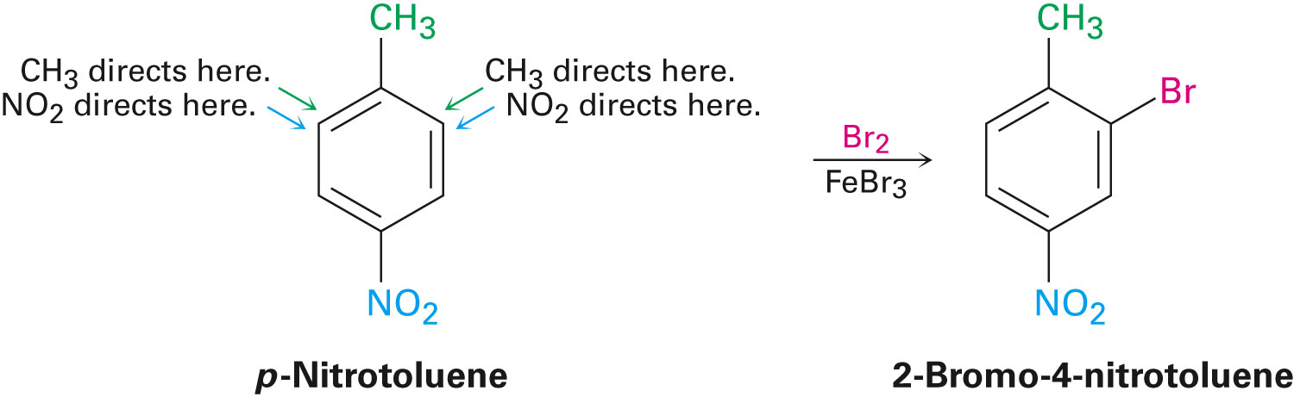
Tri-substituted Benzenes: Additivity of Effects
Start w/ di-substituted rings
Guided by same inductive and resonance effects as mono-substituted rings
(previous slides)
However NOW we must consider the additive effects of TWO different groups…
Three Rules Apply…
Notes:
Trisubstituted benzenes: Additivity of effects
31

Slide 32
Tri-substituted Benzenes
Rule 1
If the directing effects of two groups reinforce each other – it’s somewhat
straight forward
see Handout 2a – Table 16.1
(for additive effects)
(m)
e.g.
(-o,-p)
A)
B)
*
*Note: 1) Br can’t add ( ) at para-position in A b/c NO₂ is already there!
2) Br can add at ortho-position in A b/c there is no subtituent there, however not favored…
3) Br adds at meta-position in B b/c it’s favored there (see Table 16.1)
2-3 and compliment each other ☺

Slide 33
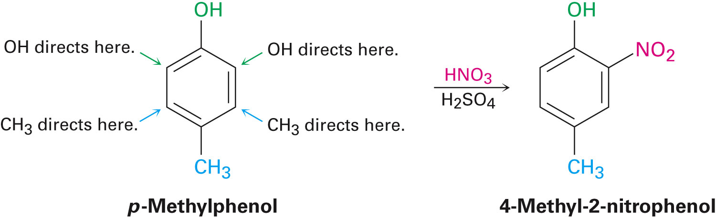
Tri-substituted Benzenes
Rule 2
If the directing effects of two groups oppose each other –
The more Reactive activating group has the dominant influence.
(m)
see Handout 2b
see Handout 2a – Table 16.1
(for additive effects)
(-o,-p)
A
B
*Note: 1) NO₂ can’t add ( ) at para-position in A b/c CH₃ is already there!
2) NO₂ can add at ortho-position in A b/c there is no subtituent there.
3) NO₂ could have added at the ortho-position in B but doesn’t b/c A is more Reactive group
2-3 compete with each other

Slide 34
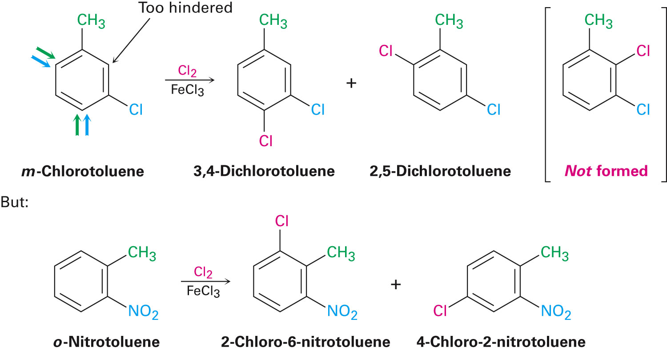
Rule 3
Substitution rarely occurs between two groups in meta di-substituted
compounds b/c the site is Too hindered.
(m)
e.g.
(-o,-p)
m
p
o
m
o
see handout 2
(for additive effects)

Slide 35
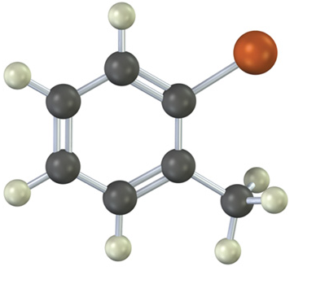
Confirming Your Knowledge
Chem 3900
Lecture 4
Worksheet 4
What is the major product(s) from the reaction of the following substances with:
HNO₃
H₂SO₄
o-Bromotoluene
orange is Br
Hint: Methyl (-CH₃) group has directing priority over Br

Slide 36

HW 16
1, 3, 7, 8, 9, 13, 14, 49 (skip c, d, g)

Slide 37
b
Handout 2b
Substituents can be classified into three groups (please annotate below)
1)
2)
3)
NOTES: 1) There are no Meta-directing activators.
2) Halogens are weakly -ortho and -para de-activating but can also be used as –ortho and-para directing activators just less then benzene.

